Slide 1
Comparative Study of NoSQL Databases
Group9

Slide 2
Member Roles
Member | Section
Ramdhan | DynamoDB, database Comparison
Maisarah | Setting up Cassandra & MongoDB, Cassandra queries, presentation
Kie | Neo4j, MongoDB queries
Alia | MongoDB, presentation
Atina | Cassandra, presentation

Slide 3
Part A
Introduction to NoSQL Database

Slide 4
DynamoDB
-[
Part A
]-
Highlights of
4 NoSQL Databases
MongoDB
Cassandra
Neo4j

Slide 5

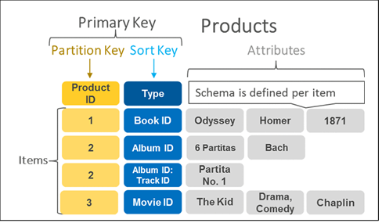
-[
Highlights
]-
DynamoDB
A proprietary database released by Amazon in 2012
Schema less
Table -> Items -> Primary key and Attributes
Support various data types
Integrates with AWS Ecosystem

Slide 6

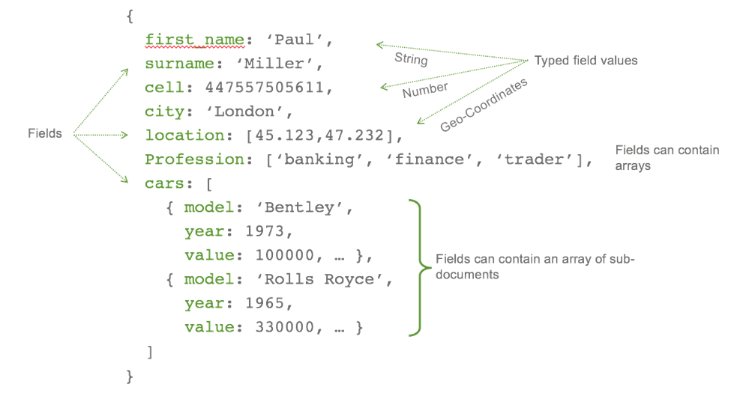
-[
HIghlights
]-
Non-relational JSON-based database written in C++ founded by 10gen in 2009
Support various and complex data types
Flexible and scalable
Lack of support for transactions
Database -> Collections -> Documents -> Keys: Values

Slide 7

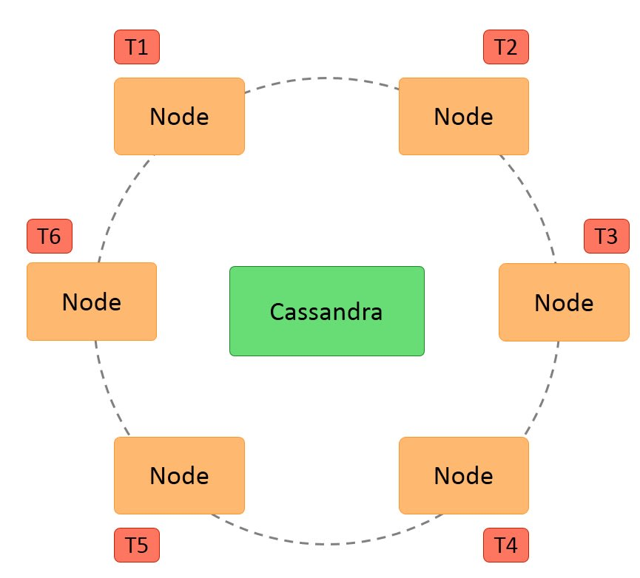
-[
Highlights
]-
An open-source NoSQL database built by Apache Software Foundation.
First developed by Facebook team.
Peer-to-peer distributed system.
Keyspace -> Column families -> Columnkey -> Column values
Has its own query language: CQL

Slide 8

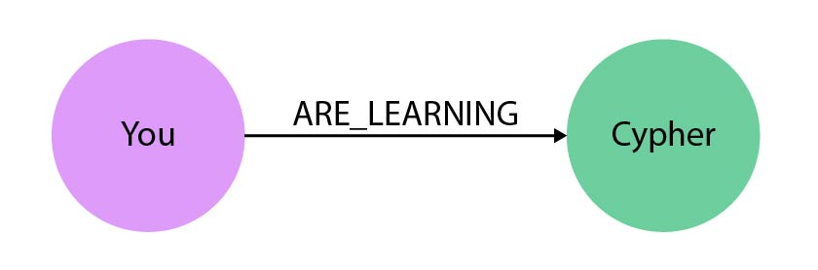
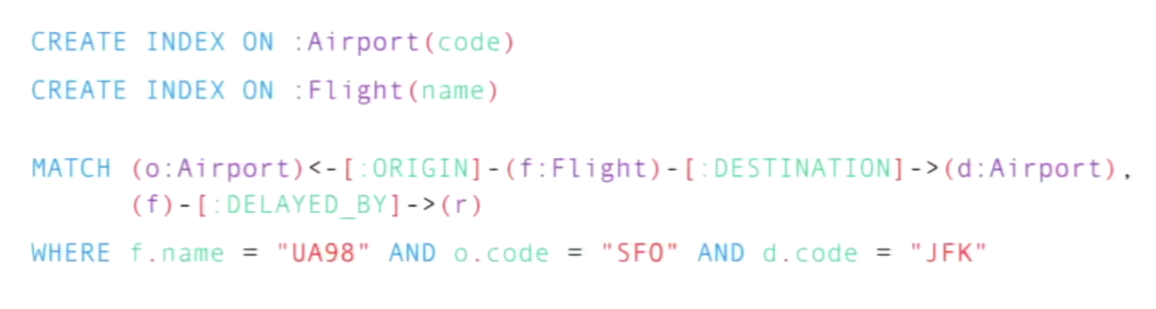
-[
Highlights
]-
Open Source - NoSQL Graph Database, ACID-compliant
Began development in 2003,
Written in Java and Scala
Available in Community, Enterprise and Government edition
Example of graph structure¹
Consists of Nodes and Relationship
Uses Cypher as its query language
¹ https://neo4j.com/developer/cypher/
² https://neo4j.com/blog/8-tips-succeeding-with-neo4j/
Example of Neo4j queries²

Slide 9
Comparison features between databases
 | DynamoDB | MongoDB | Cassandra | Neo4j
Storage Method | Unique Key-Value | Documents | Columns | Graph
License Type | Commercial | Open Source and Commercial | Open Source (Apache V2) | Open Source (GPL V3) , Commercial & Government
Format | Schema-less | Schema-less | Schema-less | Dynamic Schema
Applications | Indexing | Programming objects storage | Sparse data | Social connections
Complexity | Low | Low | Low | High
Flexibility of Schema | High | Varies | High | High
Scalability of data | High | High | Average | High

Slide 10

-[
Part A
]-
Recommendation
There is no "one solution fits all", each NoSQL has its own trade-off
DynamoDB's integration with AWS ecosystem makes it a user-friendly and highly flexible solution. However, its not an open-source
Cassandra's peer-to-peer architecture guarantee a high fault tolerance, but it's the least scalable
MongoDB's JSON support makes it a highly-flexible solution, but it lacks automatic transaction support
Neo4j is a great solution for handling a growing large volume of connected data, but it’s the most complex among others
Next: PartB

Slide 11
Part B
Comparison between MongoDB & Cassandra queries

Slide 12
-[
Part B
]-
Description of dataset
Crime Dataset
Records of crimes in the City of Chicago, U.S.
Originally created by Chicago Police Department's system
From 2001 to present, excluding the most resent one week
Size: 1.41 GB
Consists of 23 keys/columns and 12,534,454 collection of documents/rows

Slide 13






Implementation & Installation Process
Dataset2.csv
Notes:
Implementation using Google Cloud Platform.
1. Upload dataset file into Google Cloud Storage
2. Link Google Cloud Storage with Google Cloud Compute Engine (VM). Copy files to VM Filesystem
3. Load data from files into Cassandra & MongoDB.

Slide 14
Demo
https://www.youtube.com/watch?v=cEARjiXhsqc

Slide 15
Results
Query
Time execution in Cassandra
Time execution in MongoDB
1
Loading Data from CSV file into Database
7 minutes, 49.195 seconds
47.666 seconds
2
Snapshot of 1000 data list
0.003 seconds
0.037 seconds
3
List of 1000 successfully arrested crime ​
0.009 seconds
0.038 seconds ​
4
List of 1000 Theft cases
0.011 seconds
0.057 seconds
5
List of 1000 crimes happen on the Street
0.008 seconds
0.071 seconds
6
List of 1000 theft cases happen on the street in 2016
0.114 seconds
2.292 seconds
7
List of 1000 crimes happened after 2010
0.009 seconds
0.934 seconds
8
List of 1000 crimes happened in either 2012 or 2013
-
10.885 seconds

Slide 16
MongoDB
Cassandra
Slower in loading dataset
Faster to execute query
Display data concurrently
Do not support OR and NOT EQUAL operator
Result in Row & Columns like SQL database.
Loading dataset is faster
Slower time to execute query
Display data in serial
Flexible
Results in JSON, easier to encode in front end application
-[
Discussion
]-

Slide 17
-[
Part B
]-
Recommendation
For unstructured data, MongoDB is the most suitable. E.g dataset from various raw records.
For structured data, Cassandra is the best option. E.g, data from big systems such as Social Media & E-commerce sites.

Slide 18
Thank You

